Slide 1
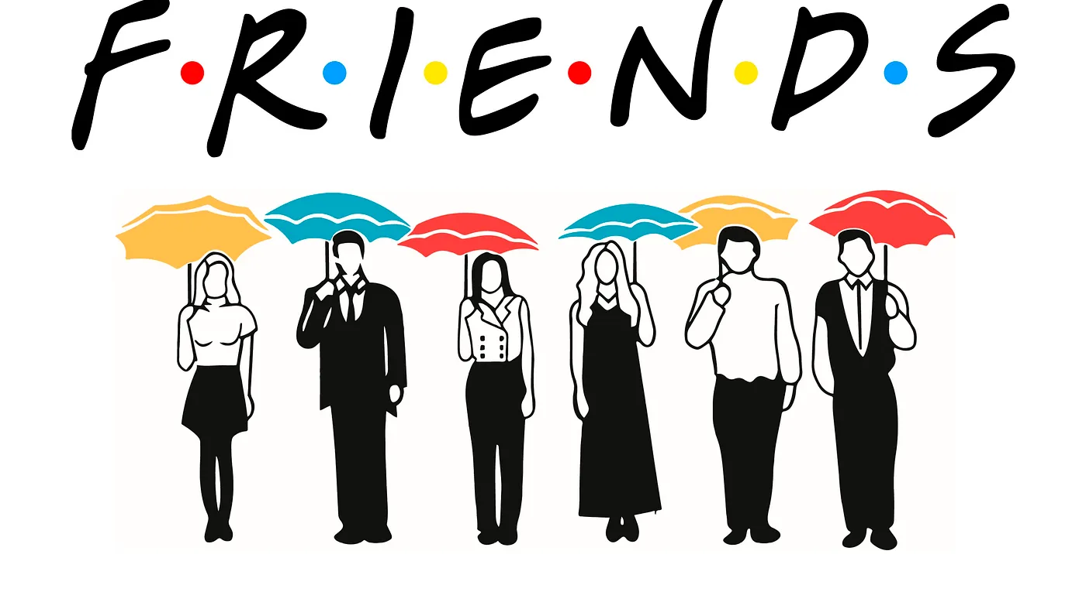
Visualization in R

Slide 2
INTRODUCTION
This project explores sentiment patterns in the iconic TV series "FRIENDS" using a dataset sourced from Kaggle.
The objective is to gain insights into the emotional tones and expressions of the characters across various seasons and episodes
Sentiment analysis is a powerful tool that allows us to understand the emotional context of dialogue and interactions in the show.
Join us as we delve into the world of FRIENDS and uncover interesting patterns in the characters' sentiments

Slide 3
Data Overview
The dataset used for this analysis is sourced from Kaggle and comprises text data from the popular TV series "FRIENDS."
The dataset includes transcripts of dialogue from all episodes across multiple seasons.
Number of Episodes: 236
Number of Seasons: 10
Total Characters: 6 main characters (Ross, Monica, Rachel, Joey, Chandler, Phoebe) and various supporting characters.
The data provides a rich source for sentiment analysis, allowing us to explore the emotional dynamics and interactions among the characters throughout the series.

Slide 4

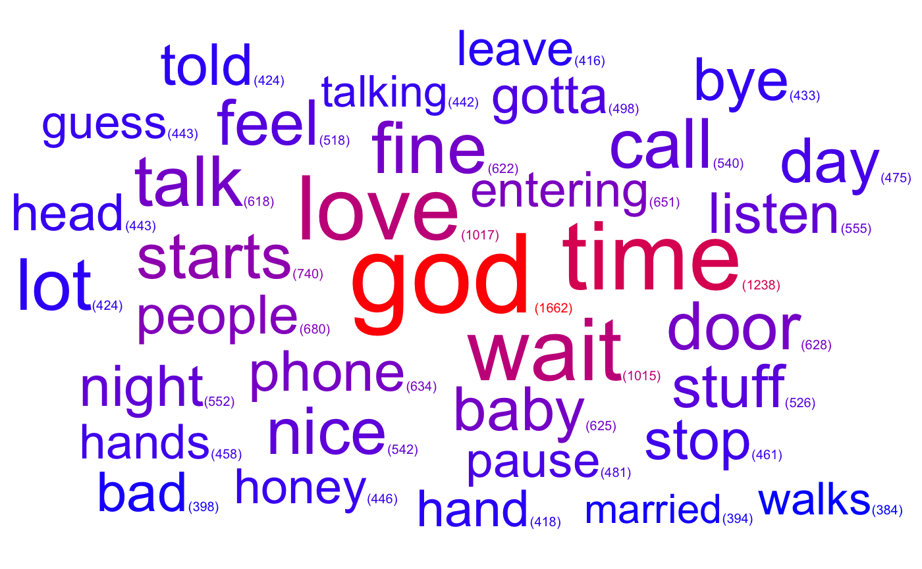
Visualizing the Words The most frequently used words in all the series.

Slide 5
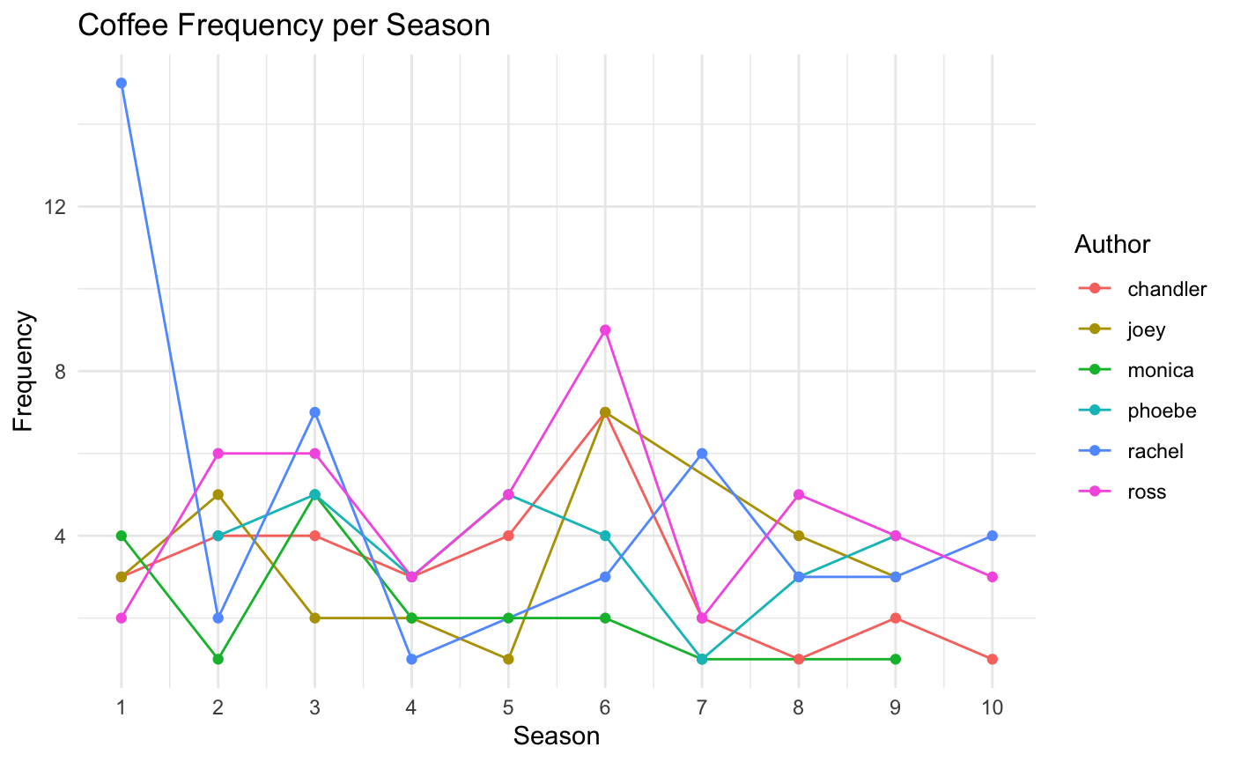
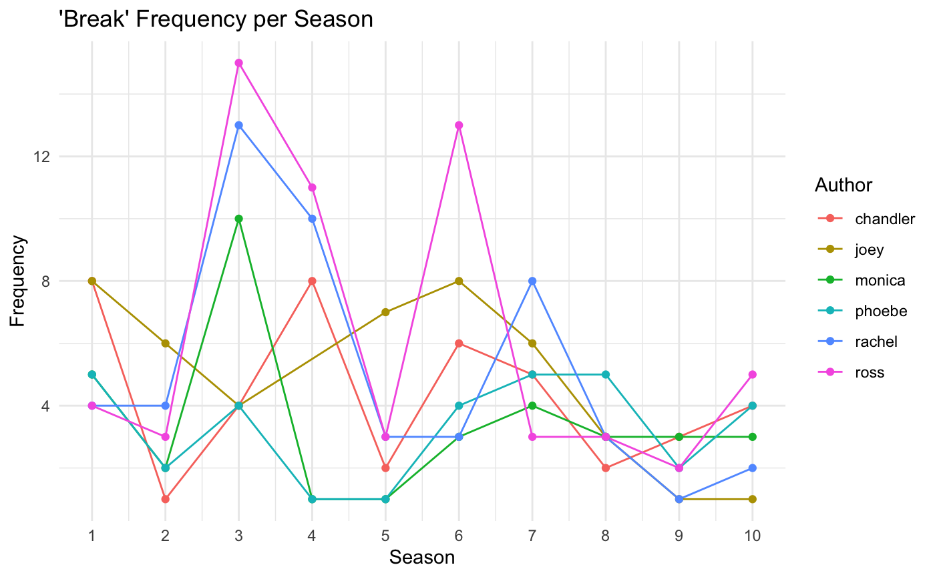
Term frequency trends
The frequency of characters using the words ‘Break’ and ‘Coffee’

Slide 6
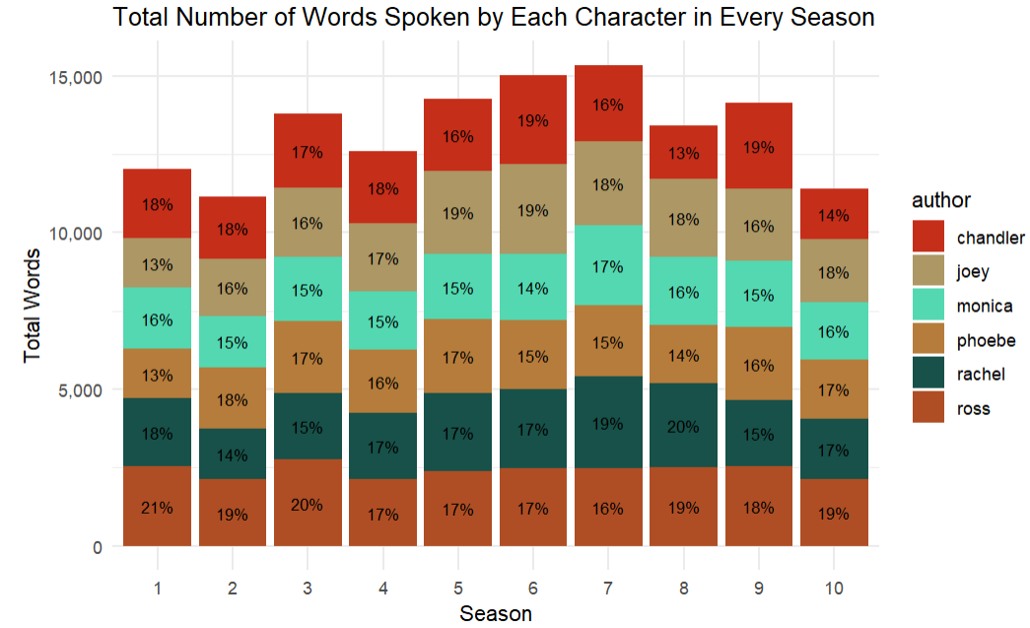
WORDS SPOKEN BY EACH CHARACTERS
The percentages represent the proportion of words spoken by each character in each season, providing insights into their respective roles and contributions to the dialogue throughout the series.
The distribution of words spoken by each character helps to understand their prominence and involvement in different seasons.
This analysis sheds light on the character dynamics and storytelling focus across the ten seasons of FRIENDS.

Slide 7

Lexicons Used for Sentiment Analysis
Bing Sentiment Lexicon: The Bing Sentiment Lexicon is a sentiment analysis resource developed by Microsoft. It provides a list of words, each associated with a sentiment score indicating whether the word is positive or negative.
NRC (National Research Council) Emotion Lexicon: The NRC Emotion Lexicon is developed by the National Research Council of Canada. It goes beyond traditional positive and negative sentiment analysis by categorizing words into various emotion categories, such as joy, sadness, anger, surprise, and more.
AFINN Lexicon: The AFINN (Affective Norms for English Words) Lexicon is a list of English words rated for sentiment polarity. Developed by Finn Årup Nielsen, each word in the lexicon is assigned a numeric score reflecting its sentiment polarity, ranging from negative to positive.

Slide 8
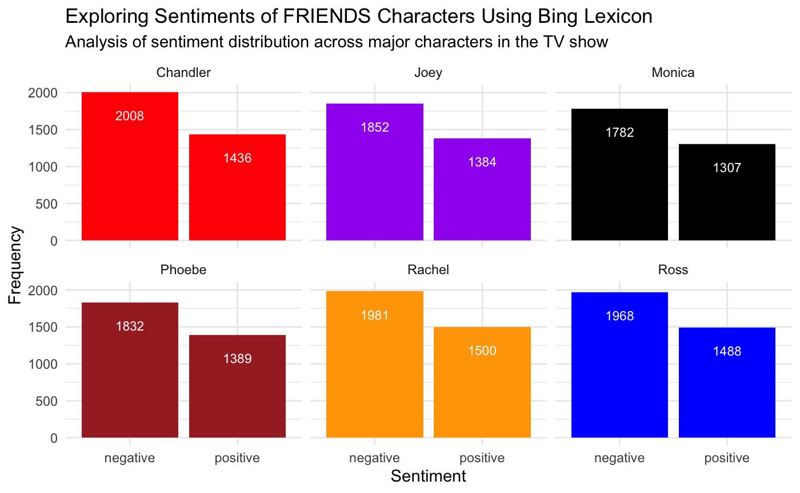
Sentiment Analysis - Bing Lexicon
The bar chart illustrates the distribution of sentiment across characters, highlighting their predominant emotional tones
Negative sentiment frequencies reflect instances of more pessimistic.
Positive sentiment frequencies reflect instances of more optimistic
Observation Suggests that Rachel has the highest frequency of negative sentiment, while Chandler has a higher frequency of positive sentiment when compared to the rest.

Slide 9
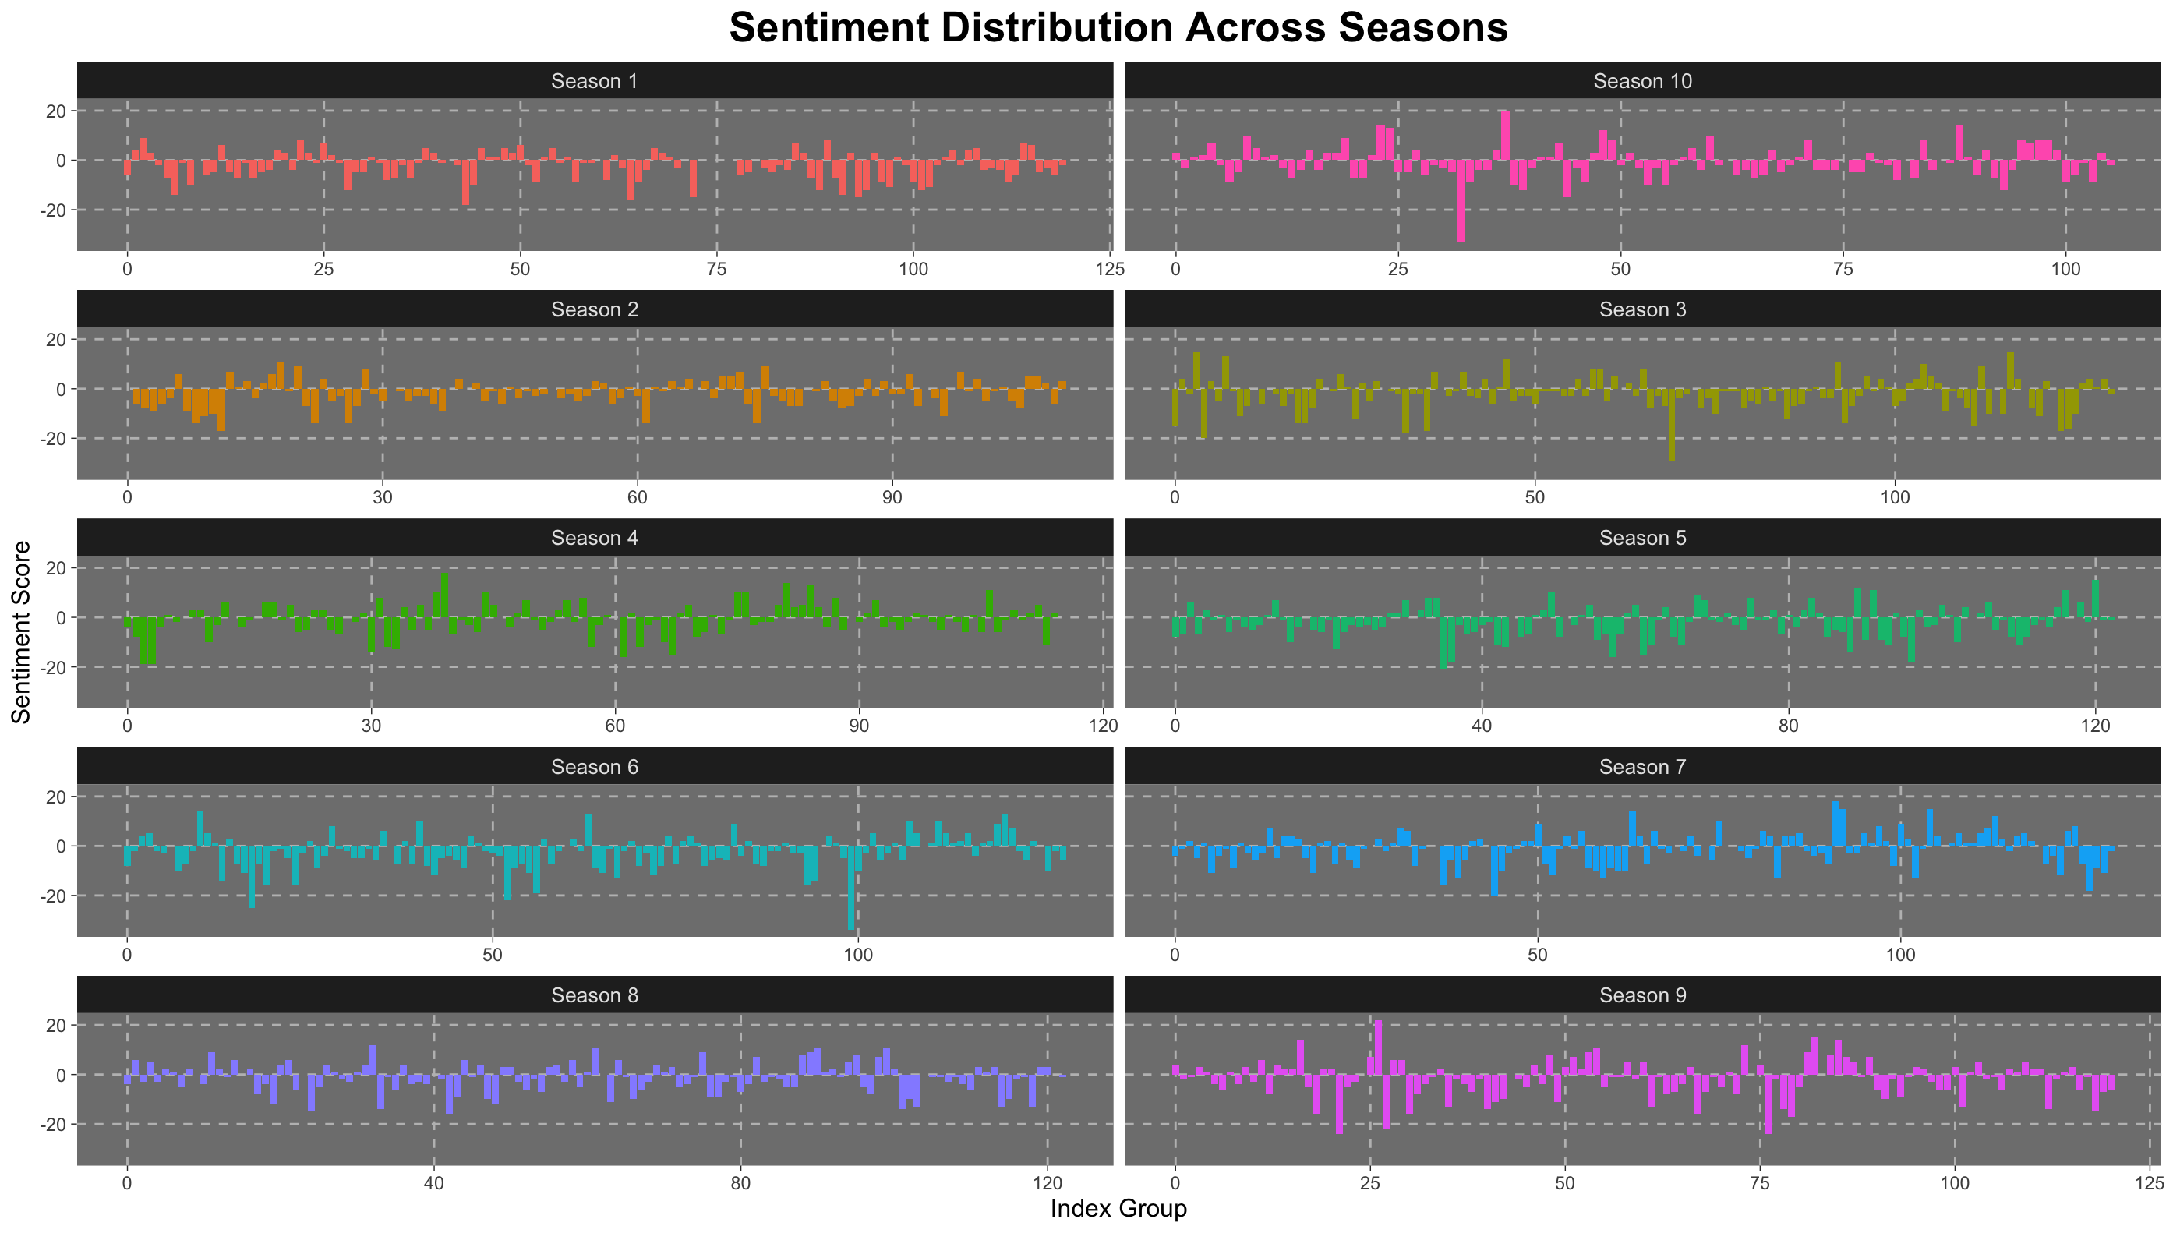
Sentiment Across Seasons

Slide 10
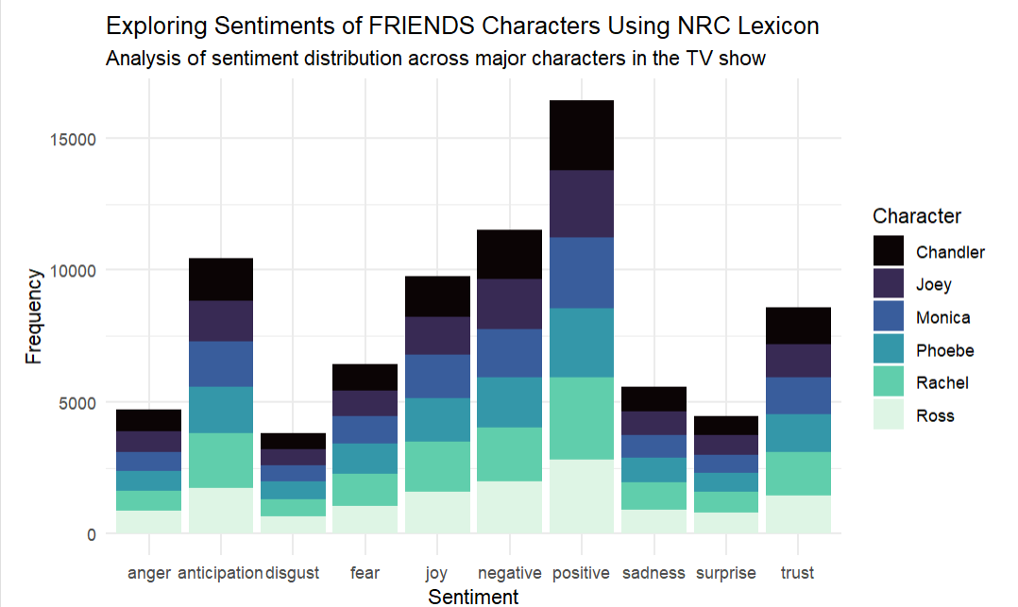
Sentiment Analysis - NRC Lexicon
Using a different lexicon we can further categorize the themes in the show.
Besides the two most dominant themes of positive and negative emotions, we can observe that the characters also exhibit emotions of trust and anticipation.
One more interesting observation here is that the all of the emotions are more or less uniformly divided for all characters.

Slide 11
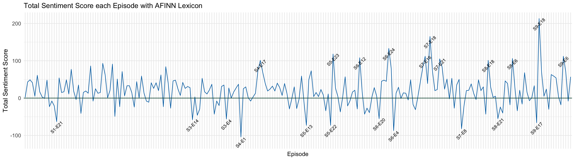
AFINN Lexicon - Episode Sentiment Scores
The AFINN Lexicon analysis provides insights into the sentiment scores for individual episodes of FRIENDS.
The fluctuations in sentiment scores across episodes reflect the emotional dynamics and story arcs within the series.
Episodes with increasing sentiment scores may signify moments of positivity or resolution, while episodes with decreasing scores may depict conflicts or challenges faced by the characters.

Slide 12
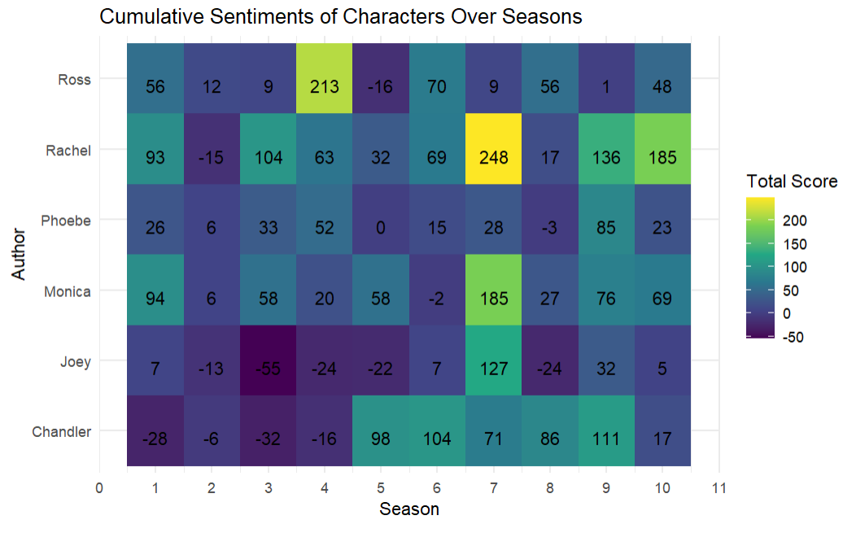
Cumulative Sentiments Over Seasons
By Character
The cumulative sentiment scores provide insights into the overall emotional trajectories of each character throughout the series
Ross shows varied sentimental pattern across season with high sentiment in season 4 and positive sentiment in later season
Rachel's sentiment score fluctuate with particularly high sentiment in season 7
Phoebe sentiment remains relatively stable, with slight variations across seasons.
Monica's sentiment shows a peak in season 7 with occasional dip in another season
Joey sentiment fluctuates widely across season, with season 7 showing a notably positive sentiment trend.
Chandler sentiment improves significantly
In season 5,6,7 and 8 after initial negative sentiments in earlier season

Slide 13
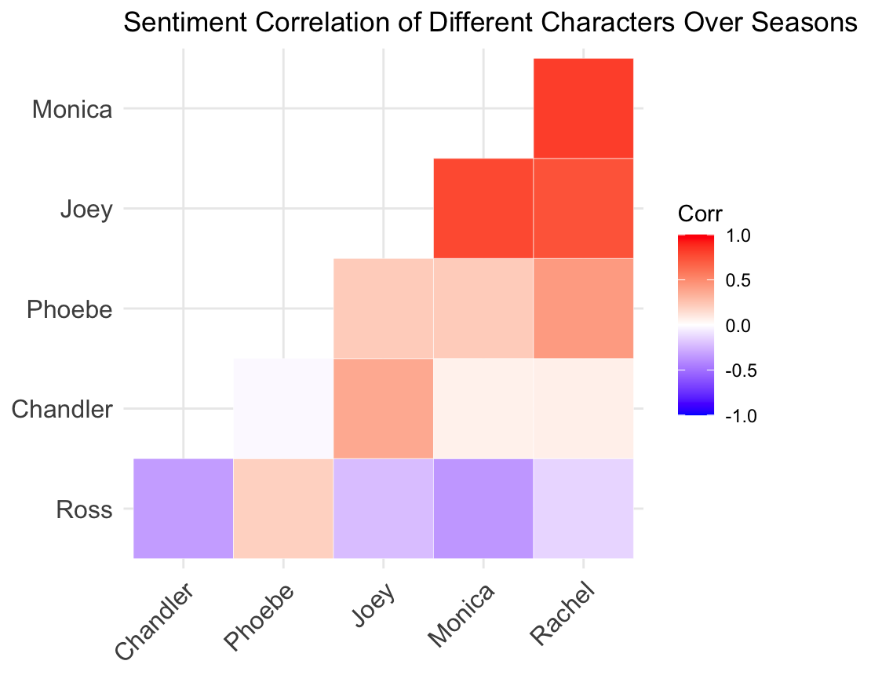
Sentiment Correlation
We also investigated the correlation between the sentiment trends of the main characters.
Joey has a strong correlation with Monica (0.78) and Rachel (0.73).
Strong emotional correlation between Rachel and Monica (0.82)
Ross's Varied Emotions:
Ross-Chandler (-0.34): The negative correlation of -0.34 suggests a moderate inverse emotional relationship between Ross and Chandler.
Ross-Monica (-0.35): Similarly, the negative correlation of -0.35 between Ross and Monica indicates a moderate inverse emotional relationship.

Slide 14
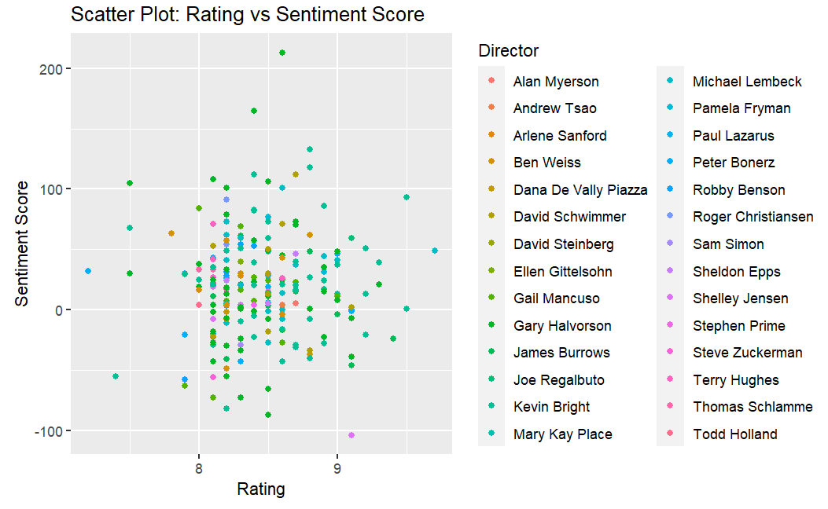
Rating vs Sentiment score
This scatter plot analyzes the relationship between the rating of FRIENDS episodes and their corresponding sentiment scores across different directors.
Episodes with higher ratings (8 and 9) are generally associated with positive sentiment scores, reflecting the audience's favourable response to the content.
The scatter plot reveals variations in sentiment scores across episodes directed by different directors, indicating potential differences in storytelling styles or thematic focus

Slide 15
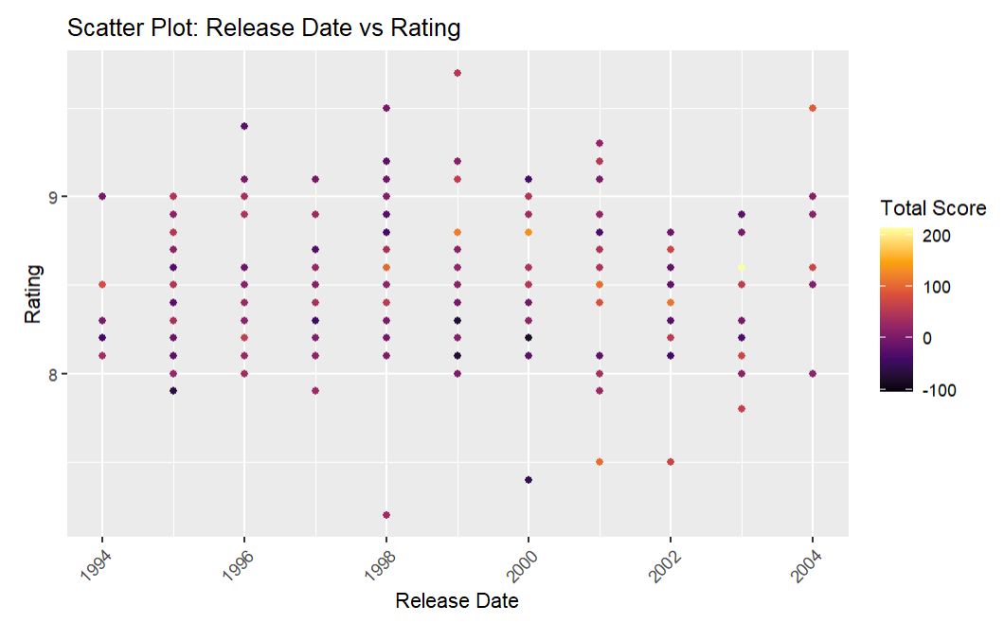
Release date VS RATING
The scatter plot illustrates the relationship between the release year and rating of FRIENDS seasons.
Across most of the seasons spanning from 1994 to 2004, the ratings consistently hover at 8 and above, with some reaching peaks of 9 and above.
Few seasons exhibit ratings of 7 and below, indicating variations in audience reception across different seasons.
The scatter plot highlights the overall positive reception and enduring popularity of FRIENDS among viewers over its decade-long run.

Slide 16

Questions?

